Slide 1

Image classification: Training a CNN using MNIST dataset
Simbiso Makunde
Machine Learning Module
MSc Data Science

Slide 2
Contents
About the MNIST dataset
Data Partitioning and Pre-Processing
How a Neural Network Works
Training the Model
Evaluation on the Test Set
Design strategy
Reflections and Conclusions
References
CNN Architecture
Accuracy & Loss Curves
Classification Report

Slide 3
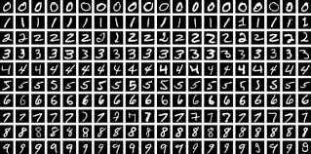
About the MNIST Dataset
60,000 grayscale images in training set
10,000 images in testing set
28x28 pixels
Labeled 0–9
Dataset is popular for machine learning, training and testing purposes (Activeloop, 2024)
Image classification problem.

Slide 4
Data Partitioning and Pre-Processing
Used sklearn's train_test_split function to randomly split the training dataset
80% training, 20% validation from the original training set.
Helps to avoid overfitting Baheti (2024).
Normalized the pixel values of the input images to optimize the training process.
One-hot encoding the classification labels for classification using Softmax function.
Shao(2022) argues that such methods might make the model focus on the most likely class and ignore other possible classes.

Slide 5
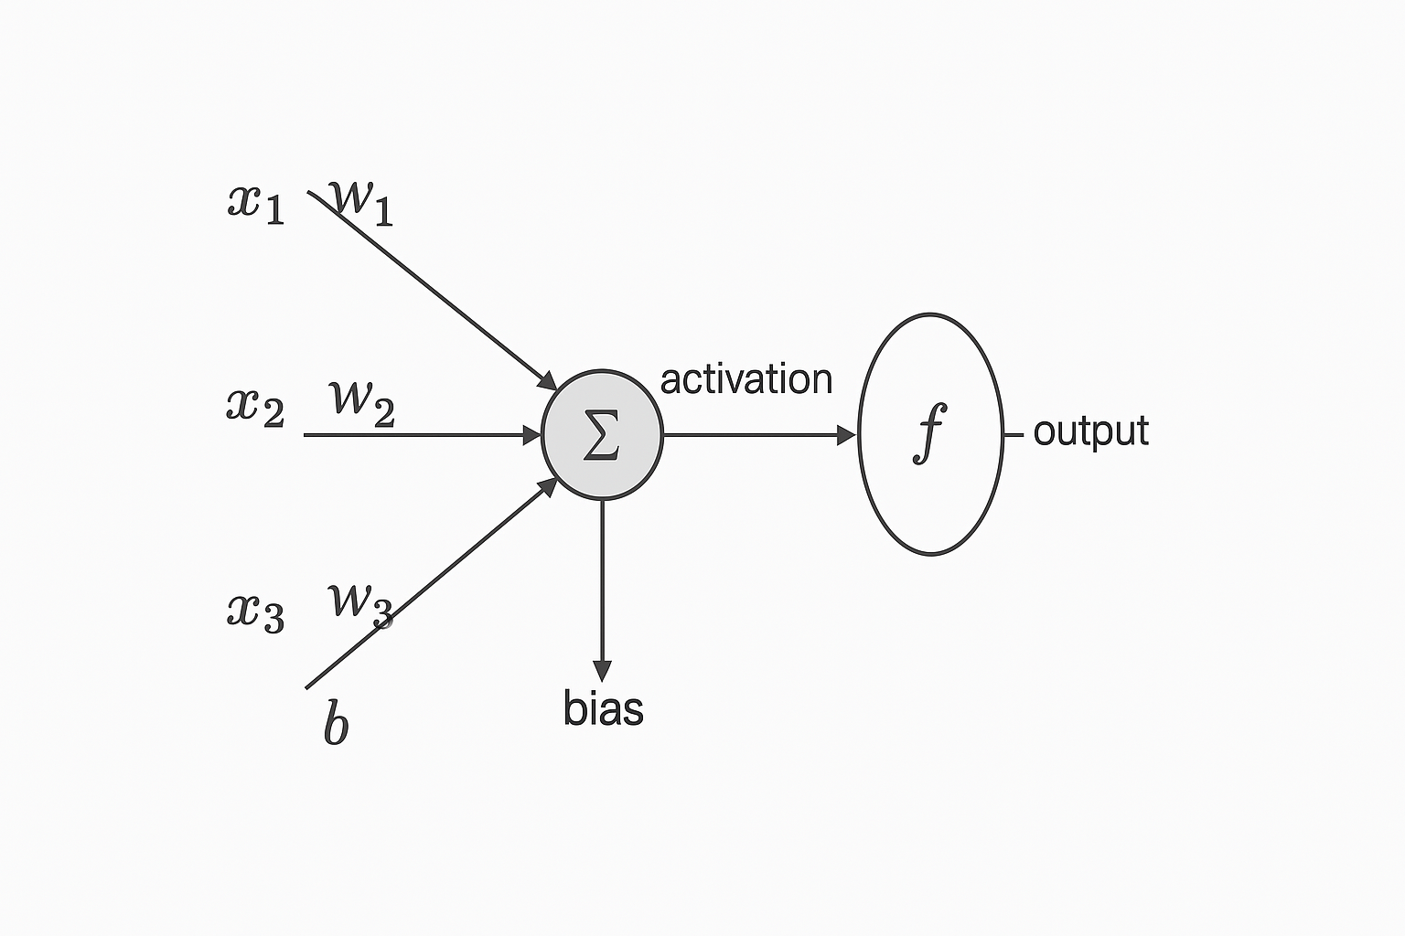
How a Neural Network Works
Neural networks are inspired by the human brain
They accept input, identify phenomena, weigh options and arrive at a conclusion (IBM, 2025)
Recurrent Neural networks suitable for forecasting and prediction tasks
CNNs for pattern recognition and classification tasks.
Neuron = weight * input + bias
Activation function transforms output
Layers of neurons stack to form deep learning models

Slide 6
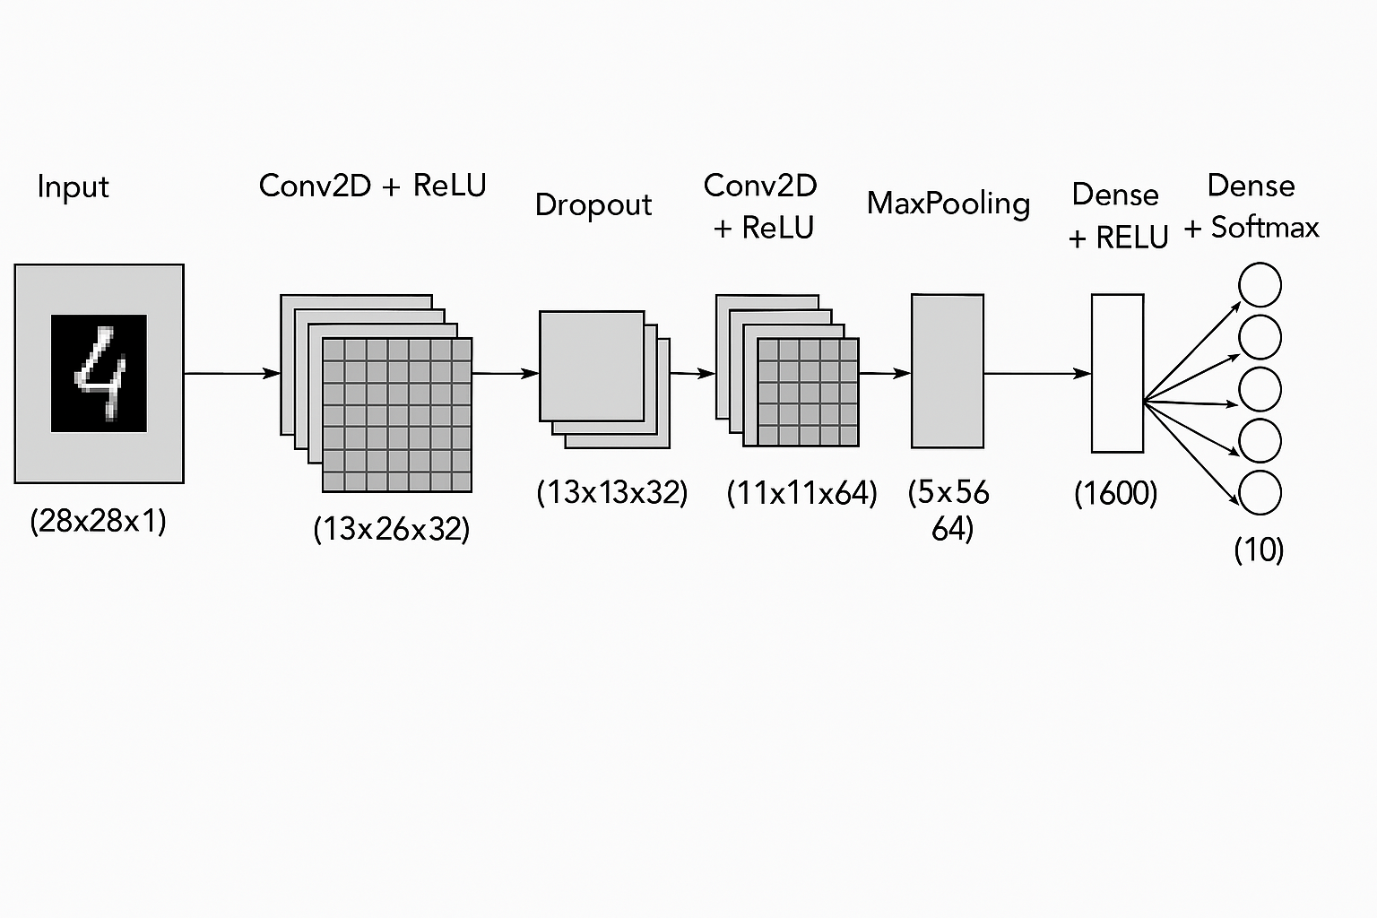
CNN Architecture
Recent research has implemented CNNs in facial recognition, document analysis etc. Seng(2021)
Conv2D layer with 32 (3x3) for feature detection,
MaxPooling2D layer reduces the size of feature maps ,
Dropout layer to improve generalisation.
Dense layer with ReLU activation function accepts the output and then passes it on to the final output layer which has Softmax activation function .
Softmax activation for classification.

Slide 7
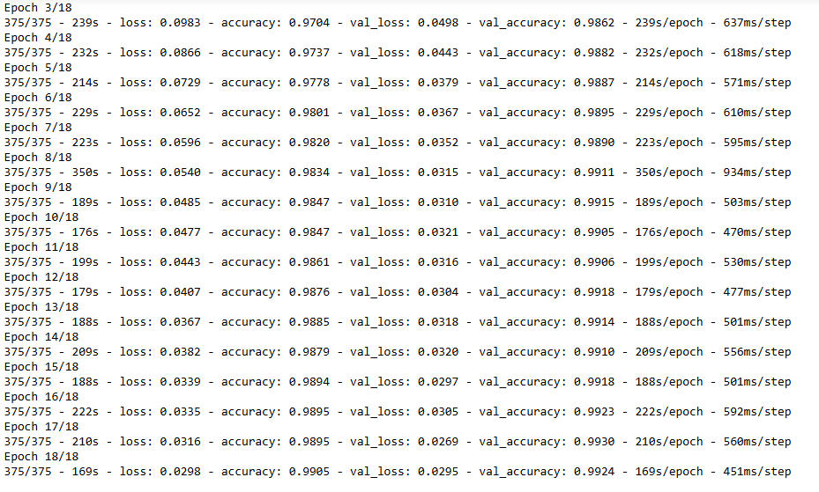
Training the Model
Epochs: 15, Batch Size: 128
Categorical cross entropy loss function to measure how well the model is performing during training.
The smaller the loss the better.
Early stopping enabled using the Validation set.
Optimizer: Adaptive Moment Estimation Optimizer (Adam)

Slide 8
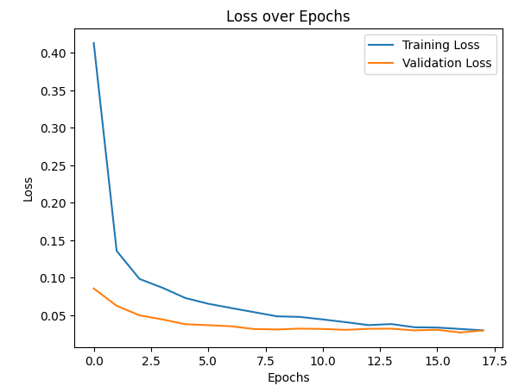
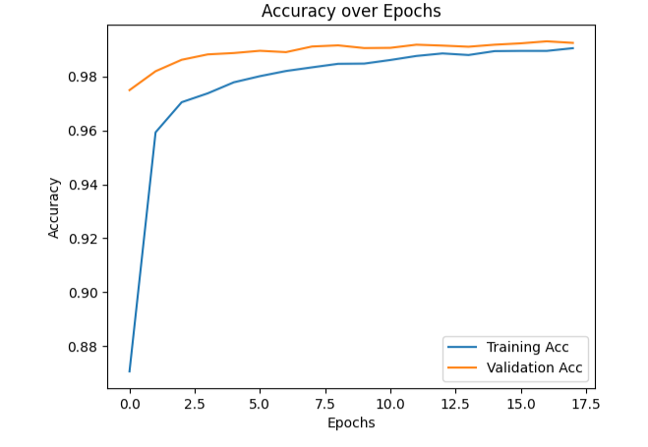
Accuracy & Loss Curves
Both training and validation accuracy improved over time.
Good generalisation through the use of Dropout layer, ReLU activation function

Slide 9
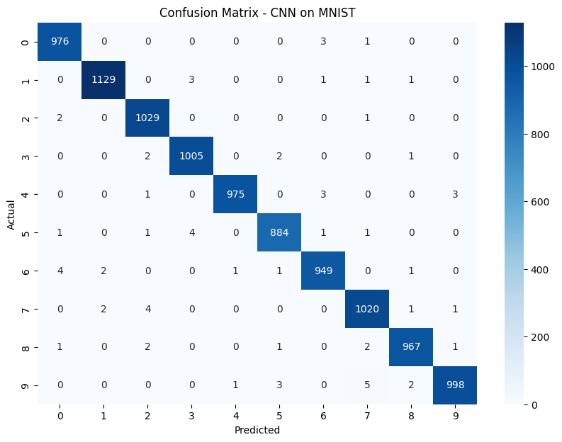
Evaluation on Test Set
Test Accuracy: 99,27% - strong generalisation
Confusion matrix shows the model had issues distinguishing between a 5 and 3 , 9 and 4 etc

Slide 10
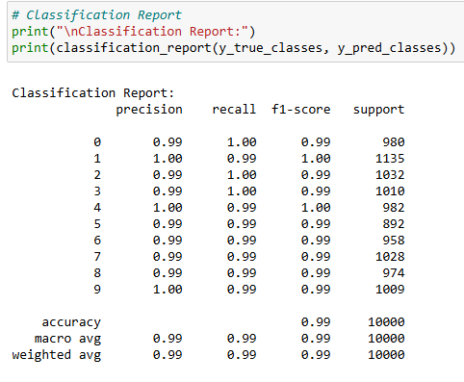
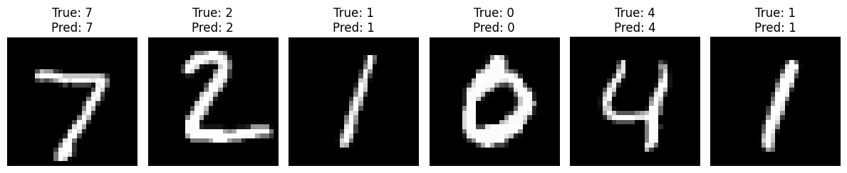
Classification Report
F1- Score either 1.00 or 0.99 for each class
Sample prediction results

Slide 11
Design Strategy
Bottom-up strategy
Validation set to monitor training
Used Dropout and ReLU to optimize the speed of the training of the model.
Multiple visualisation techniques

Slide 12
Reflection and Conclusion
Various techniques to improve generalisation.
Visualization helps to recalibrate the parameters of the CNN
The aspects of a CNN which make it better suited to image classification tasks over other neural networks.

Slide 13
References
Activeloop. (2024). Datasets MNIST. Available at: https://datasets.activeloop.ai/docs/ml/datasets/mnist/#:~:text=What%20is%20the%20MNIST%20dataset,digits%20between%200%20and%209. [Accessed: 12 April 2025]
Baheti, P. (2024). Train Test Validation Split: How To & Best Practices [2024]. Available at: https://www.v7labs.com/blog/train-validation-test-set [Accessed: 11 April 2025]
Bhati, N. (2023). Re: Normalizing a image dataset for CNN? https://www.researchgate.net/post/Normalizing_a_image_dataset_for_CNN [Accessed: 11 April 2025]

Slide 14
IBM. (2025). What is a Neural Network? https://www.ibm.com/think/topics/neural-networks#:~:text=Every%20neural%20network%20consists%20of,network%20is%20Google's%20search%20algorithm. [Accessed: 12 April 2025]
Seng, L. et al. (2021). MNIST handwritten digit recognition with different CNN Architectures, Journal of Applied Technology and Innovation. 5(1), 2600-7304 DOI: https://dif7uuh3zqcps.cloudfront.net/wp-content/uploads/sites/11/2021/01/17192613/MNIST-Handwritten-Digit-Recognition-with-Different-CNN-Architectures.pdf.
Shao, H. et al. (2022). MNIST Handwritten Digit Classification Based on Convolutional Neural Network with Hyperparameter Optimization, Intelligent Automation & Soft Computing. 36(3) DOI:http://dx.doi.org/10.32604/iasc.2023.036323

